Slide 1
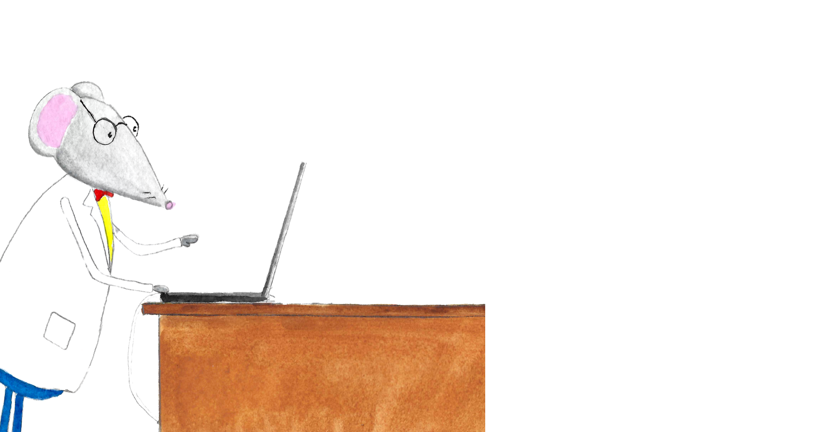

Write a Paper in
Christelinda Laureijs

Slide 2


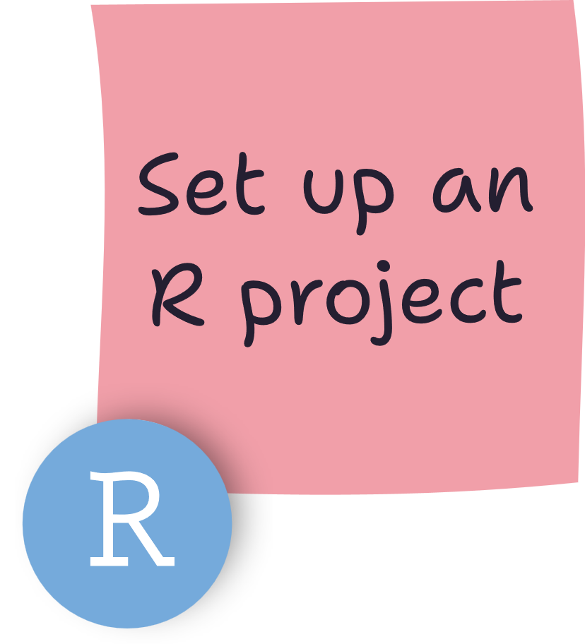
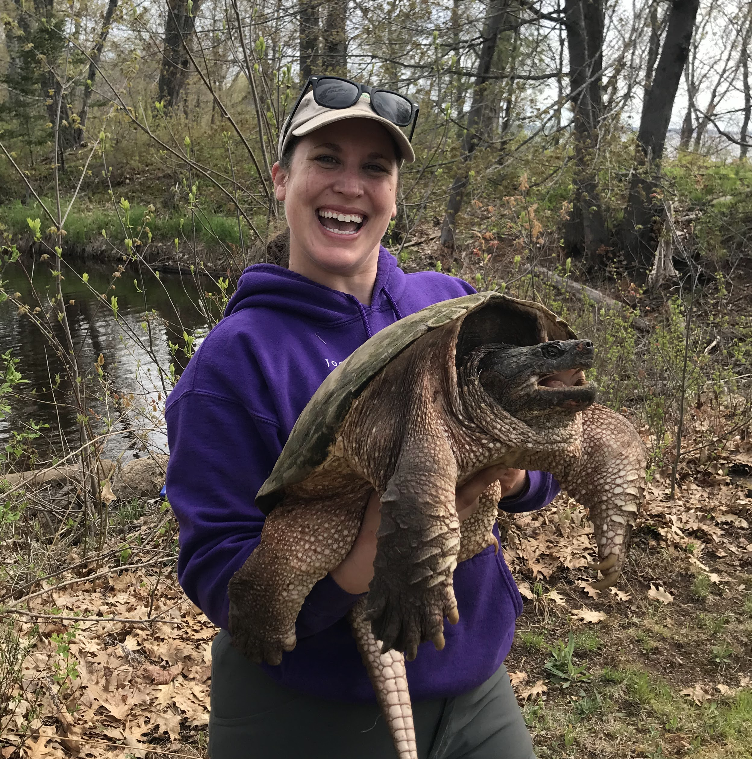
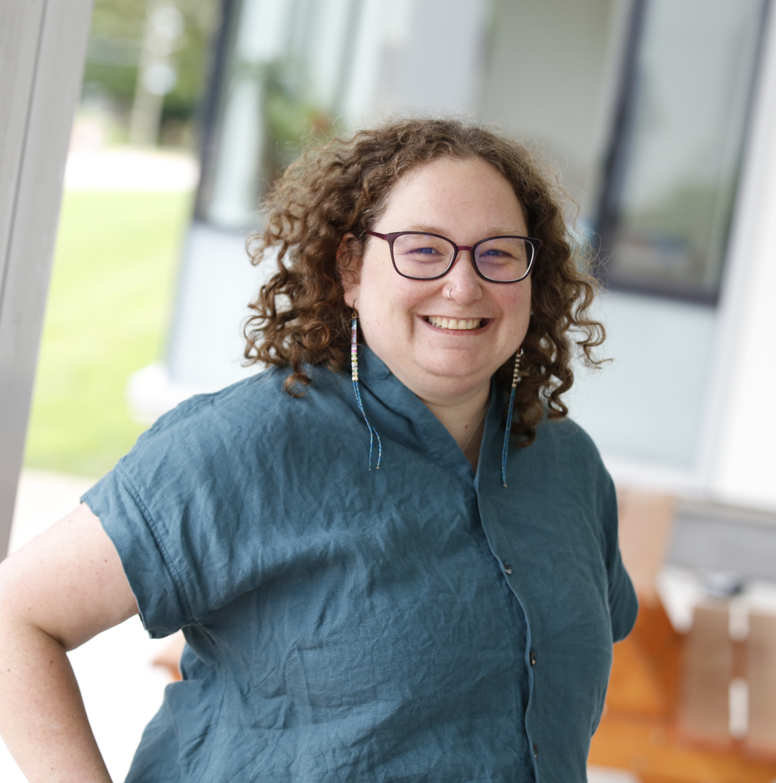
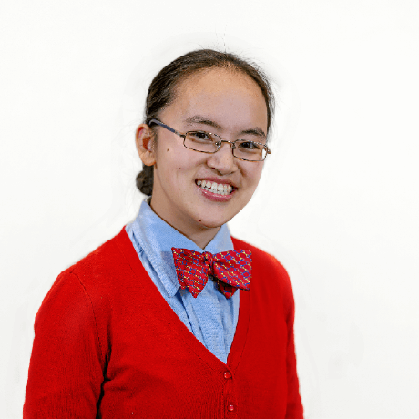
Julia Riley
Elizabeth Stregger
Christelinda Laureijs
Assistant Professor
Data and Digital Services Librarian
M.Sc. Candidate in Biology

Slide 3
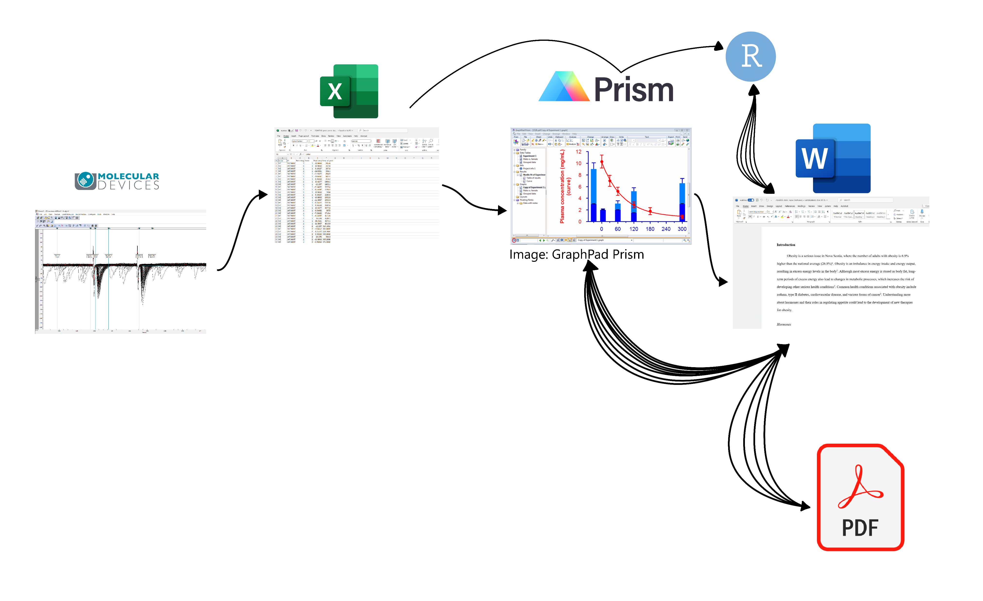
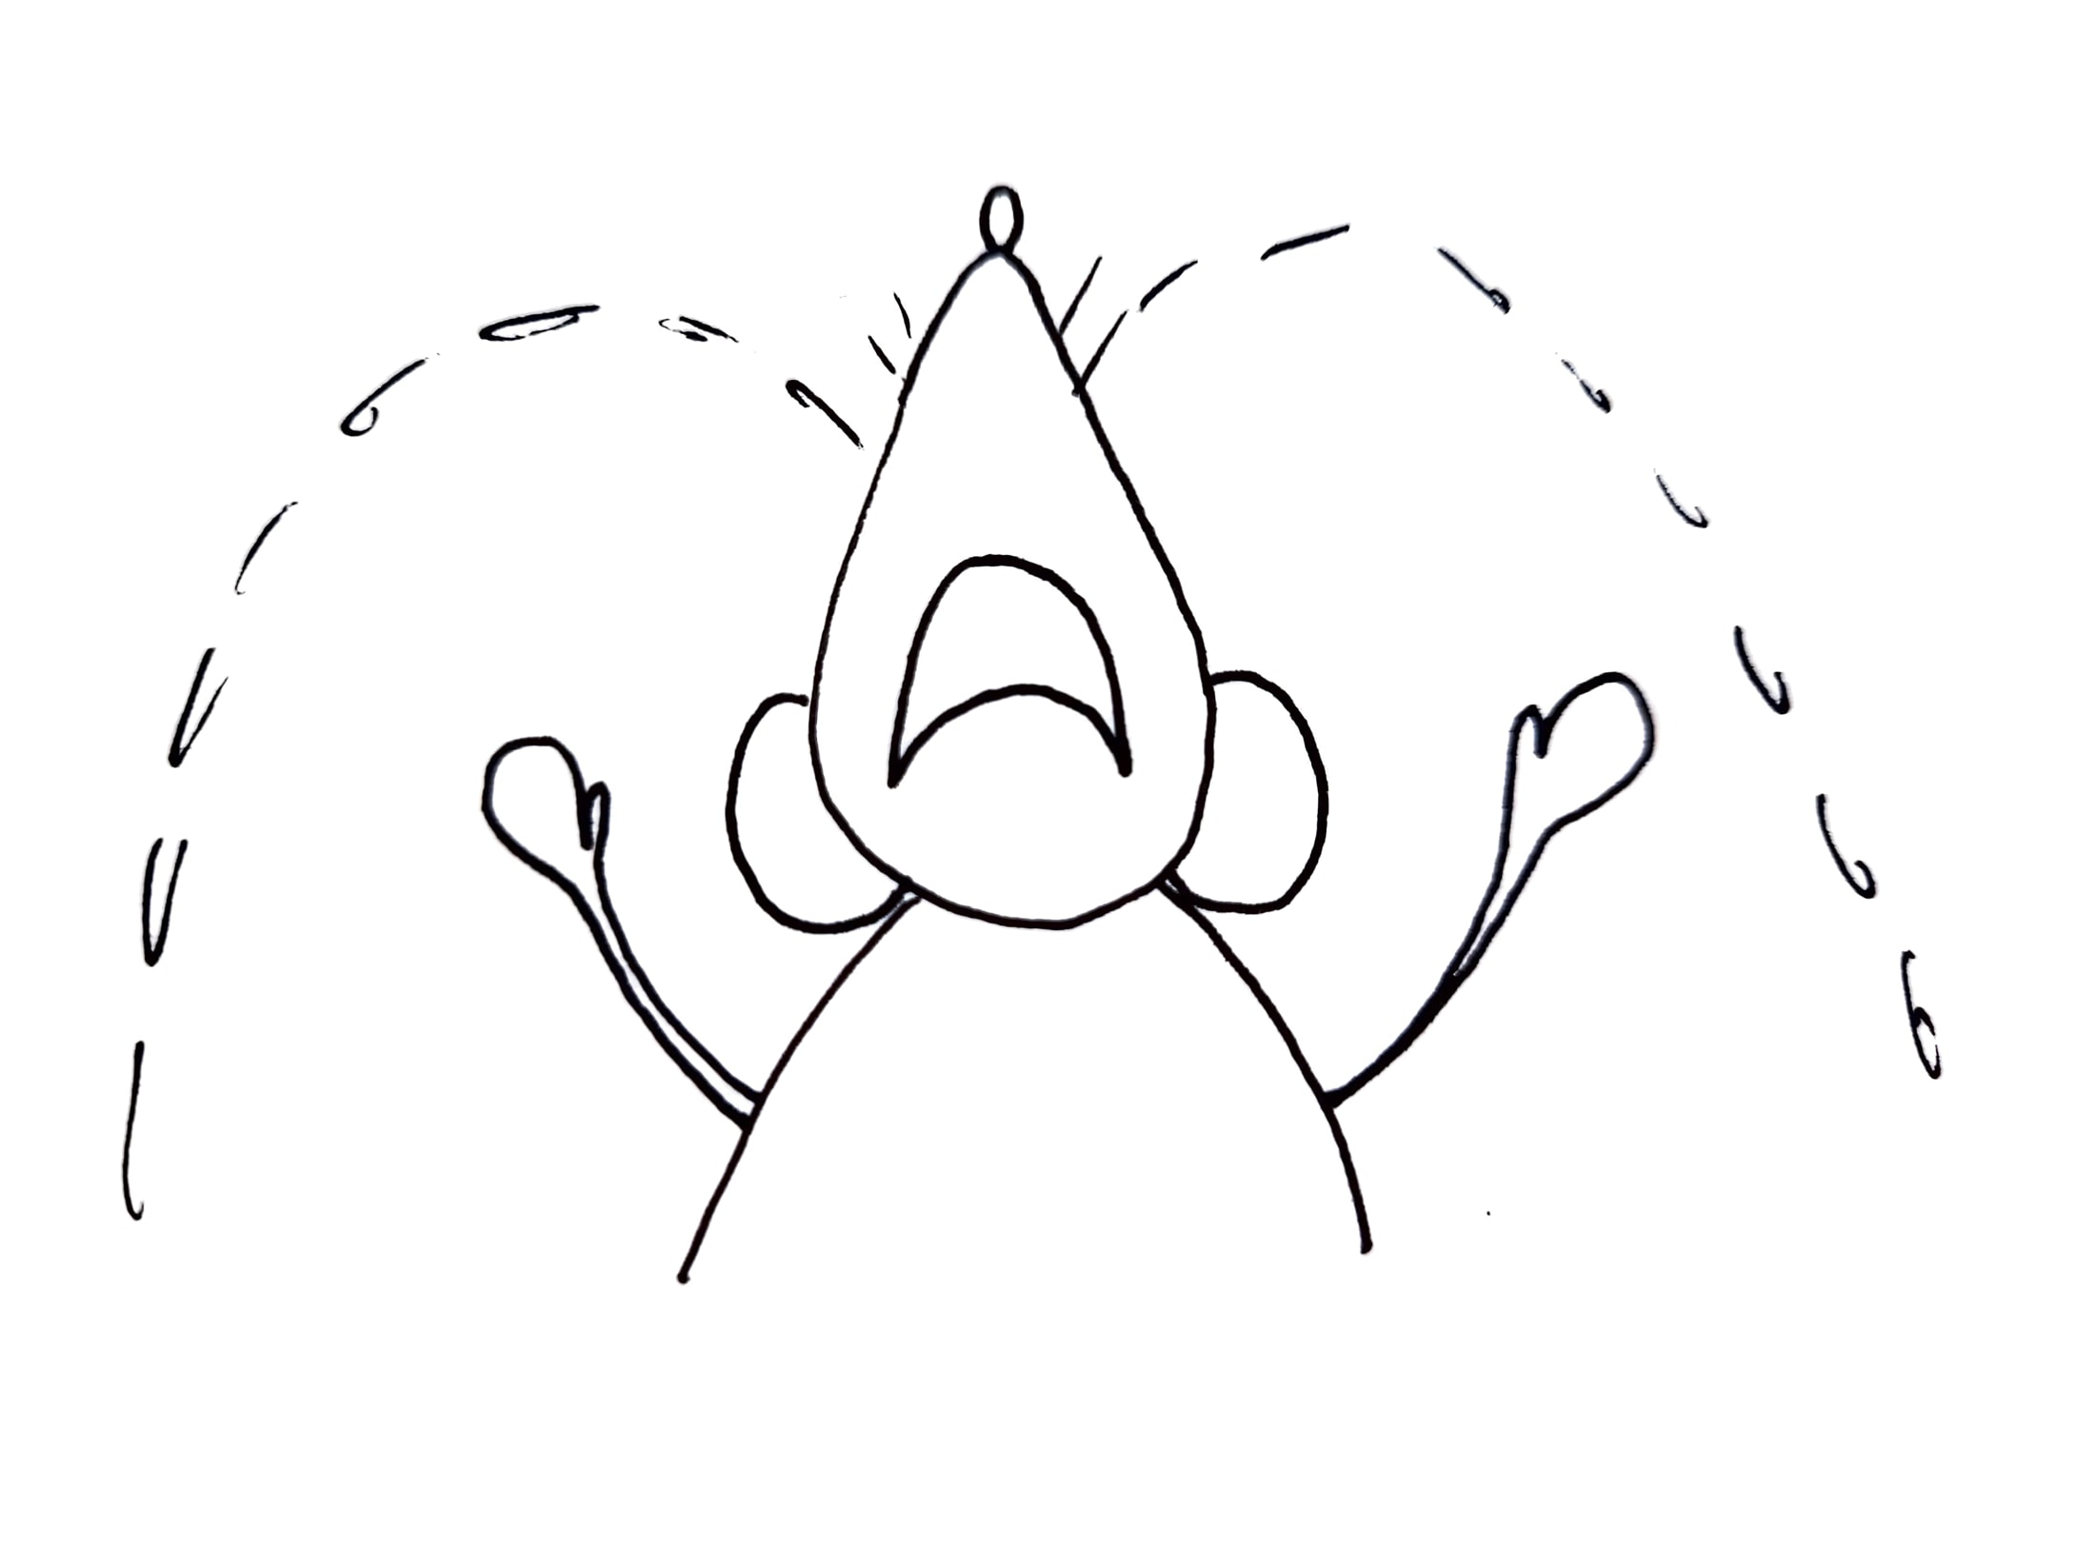

Slide 4
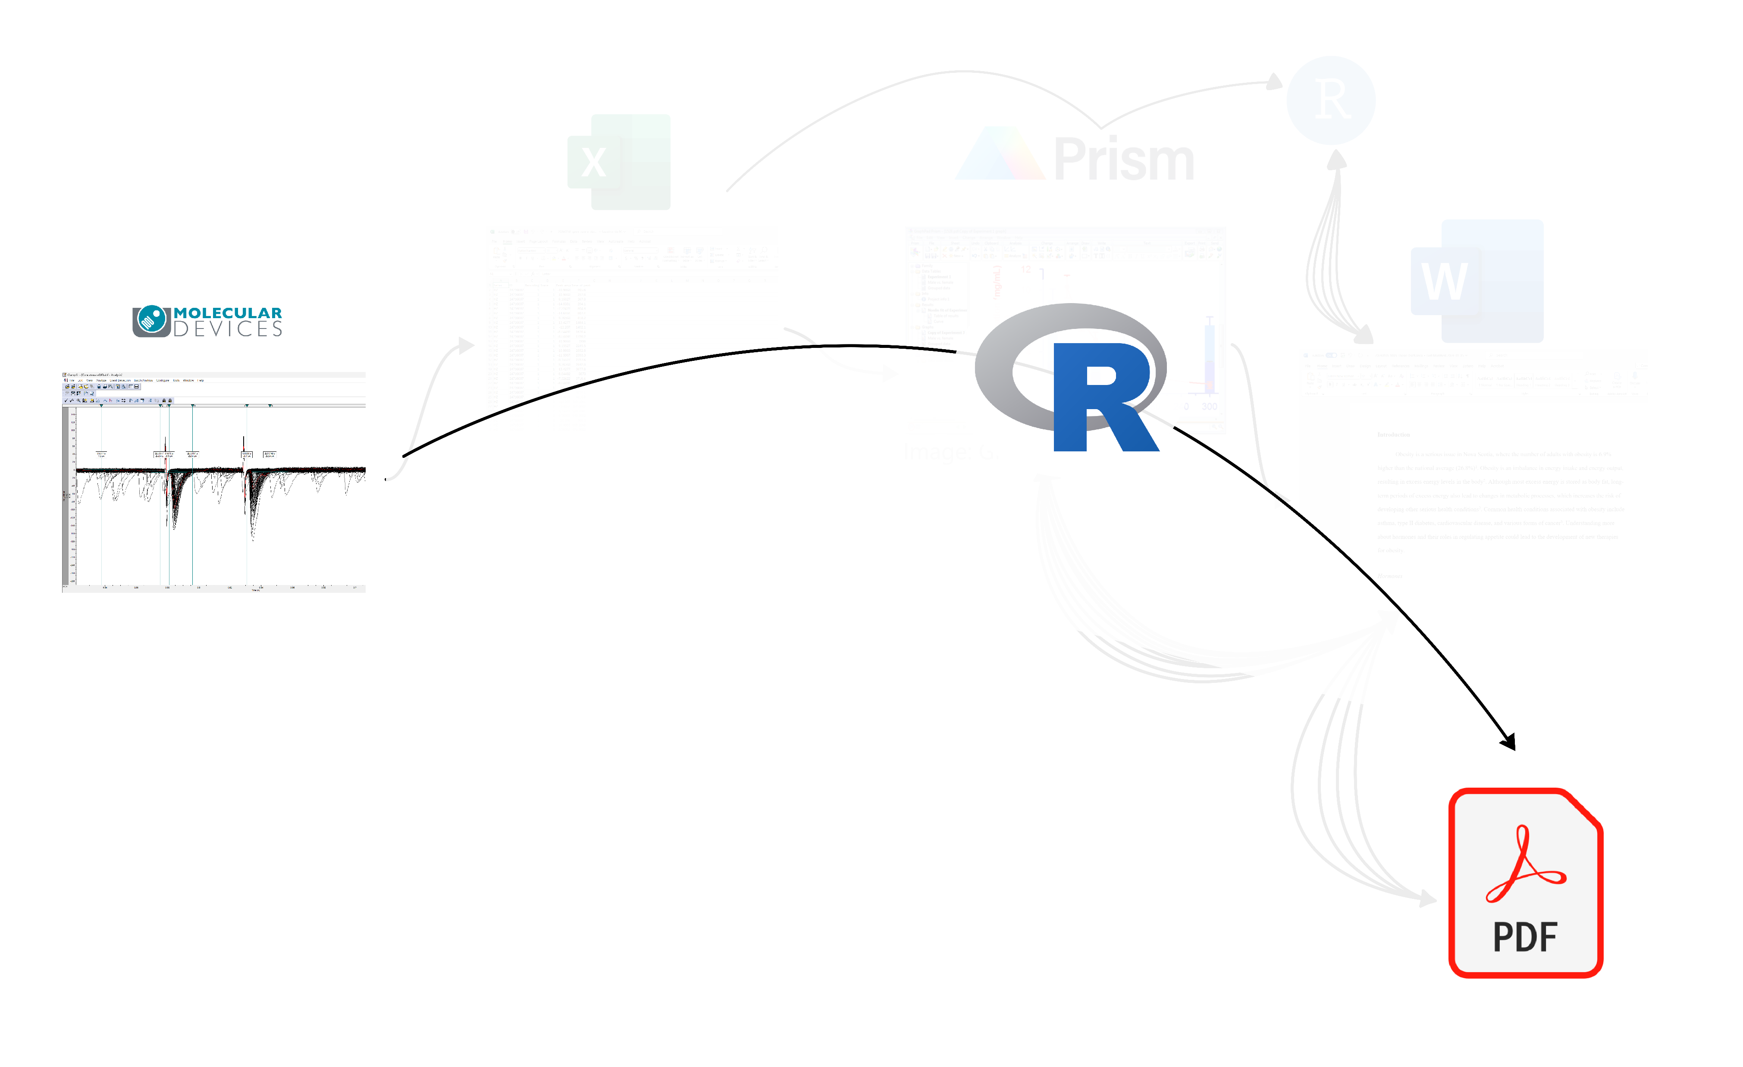
More efficient
Fully reproducible
NO MORE manual formatting!!
Plaintext files – no proprietary software, small size
Track with Git

Slide 5
This workshop covers:
Figures + captions
Inline statistics and tables
Table of Contents, list of figures …etc.
Basic LaTeX customization
Citation
This workshop does not cover:
Importing & cleaning data
Statistical analysis
Data visualization
Workshop format: Lecture + question/help period

Slide 6
1. Identify paper sections and build outline in R 2. Insert figures and captions 3. Run statistical analyses 4. Insert statistical results as tables and inline-text 5. Insert citations 6. Advanced figures 7. Customize font, page layout, margin, etc.
Knit to pdf!
Knit to pdf!
Knit to pdf!
Knit to pdf!
Knit to pdf!
Knit to pdf!
Knit to pdf!

Slide 7

CASE STUDY
My honours thesis
https://github.com/christelinda-laureijs/honours-thesis

Slide 8
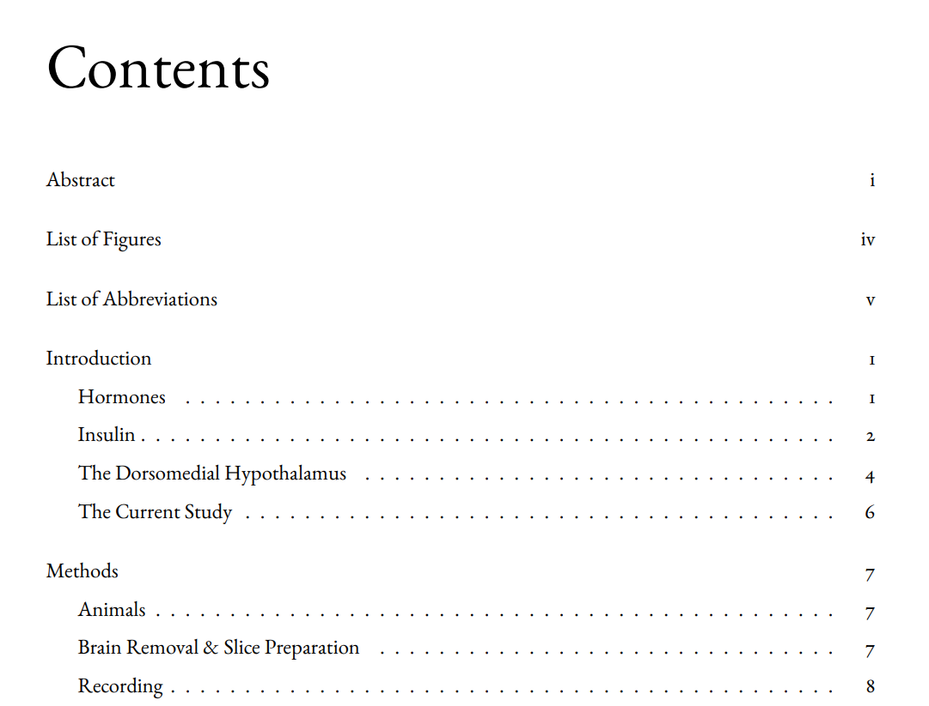
Low maintenance! Interactive!
Numbering

Slide 9
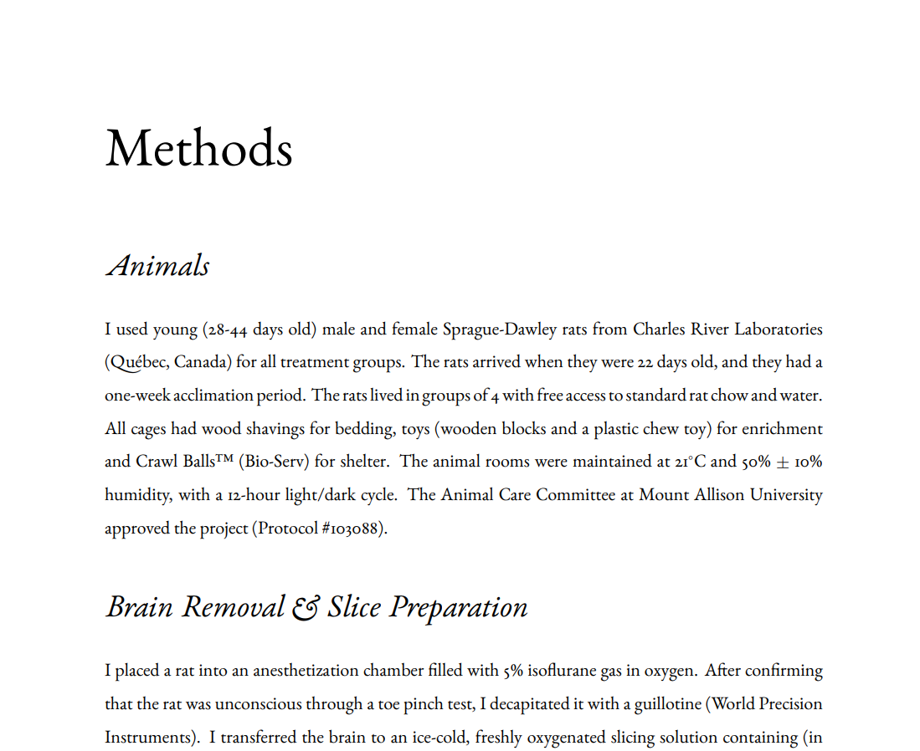
Heading 1
Heading 2
Heading 2

Slide 10

Full justification with no rivers
Advanced typography, e.g. contextual alternates

Slide 11
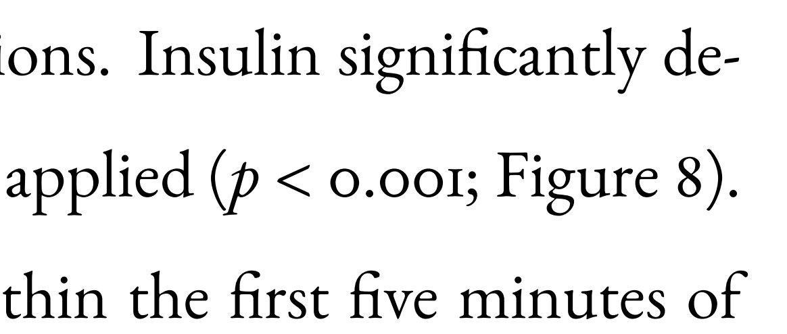
Auto-updating p-values!
Automated cross-referencing

Slide 12
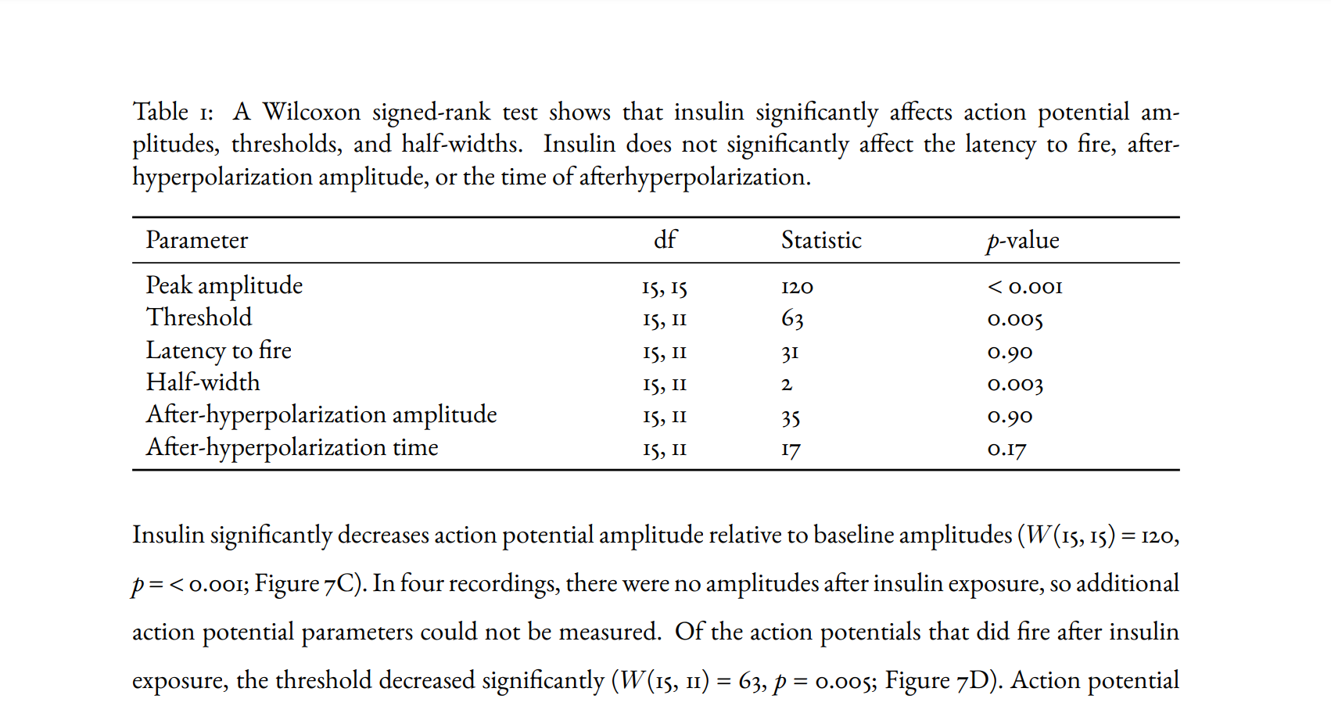
Auto-updating tables & results
In-text statistics

Slide 13
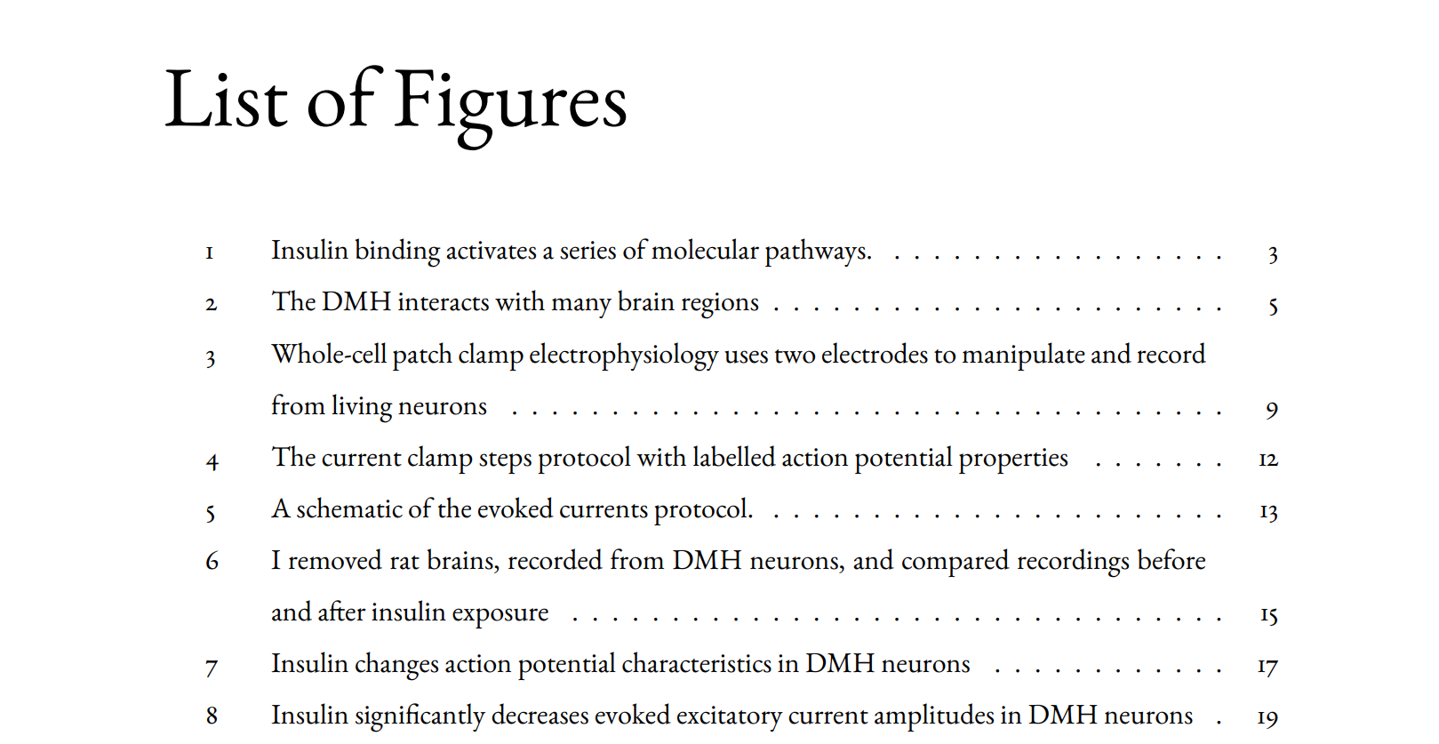
Short captions

Slide 14
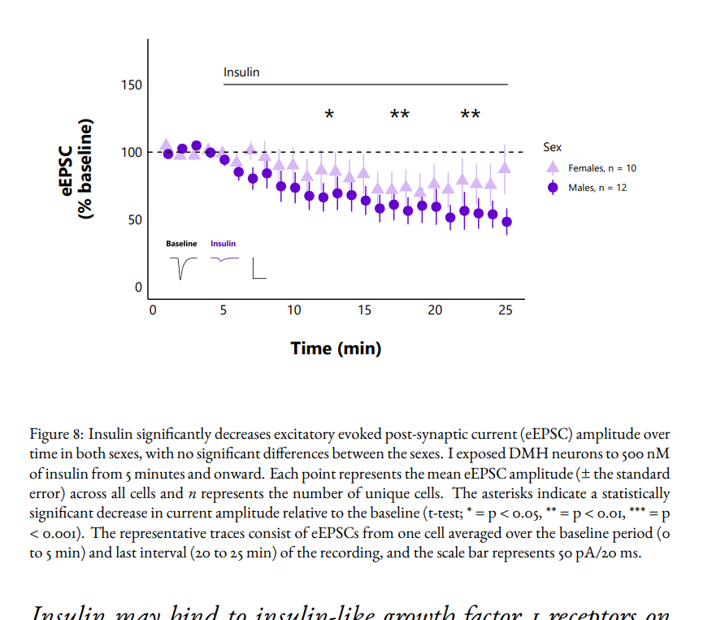
Caption
Same figure: different caption than in the list of figures!

Slide 16
Setup

Slide 17
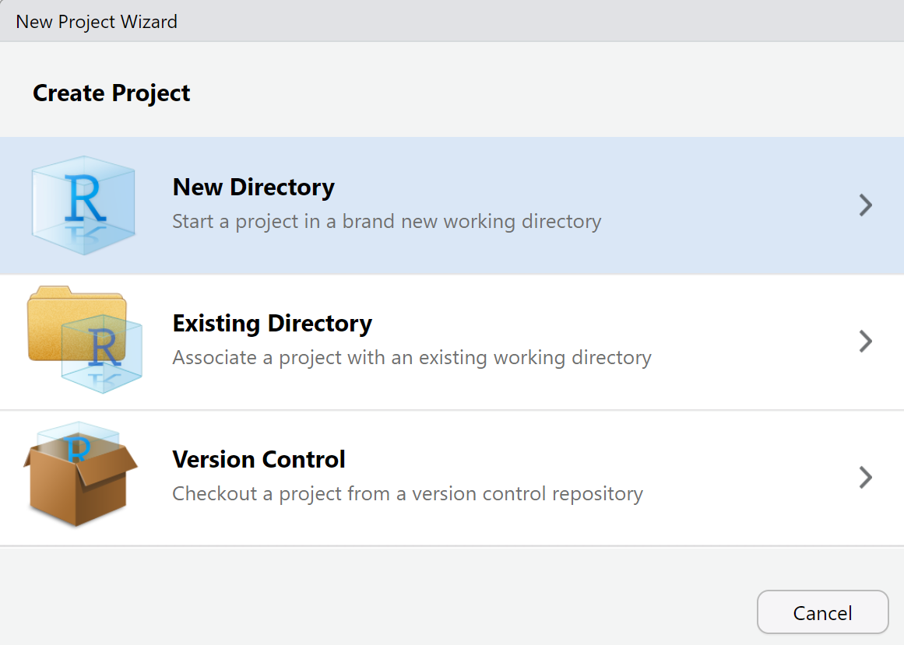
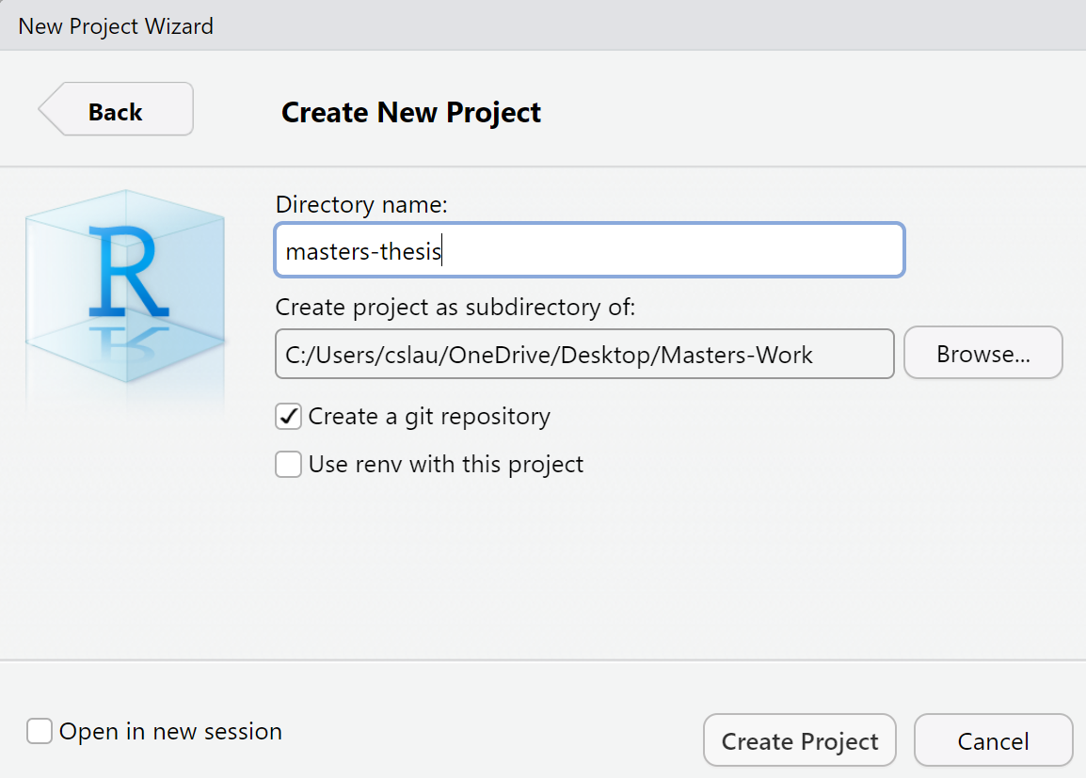
0. Open an R Project (existing or start a new one)
Important! Choose folder location here!

Slide 18
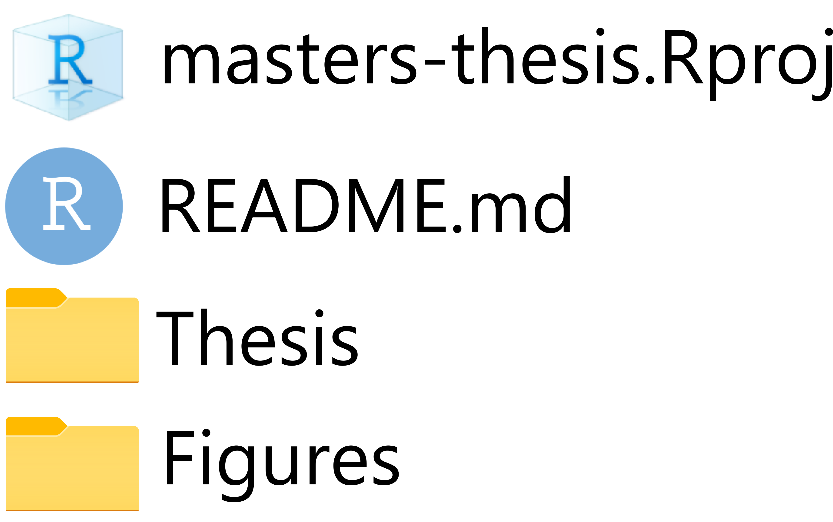
0. Set up folders

Slide 19
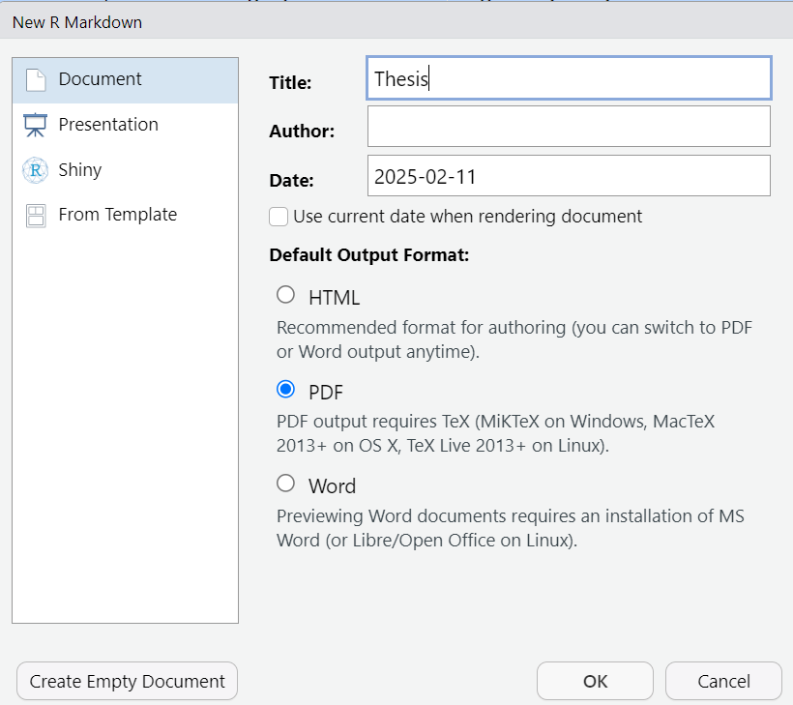
1. File → New file → RMarkdown
2a. PDF output
2b. “Save as” in the “Thesis” folder

Slide 20

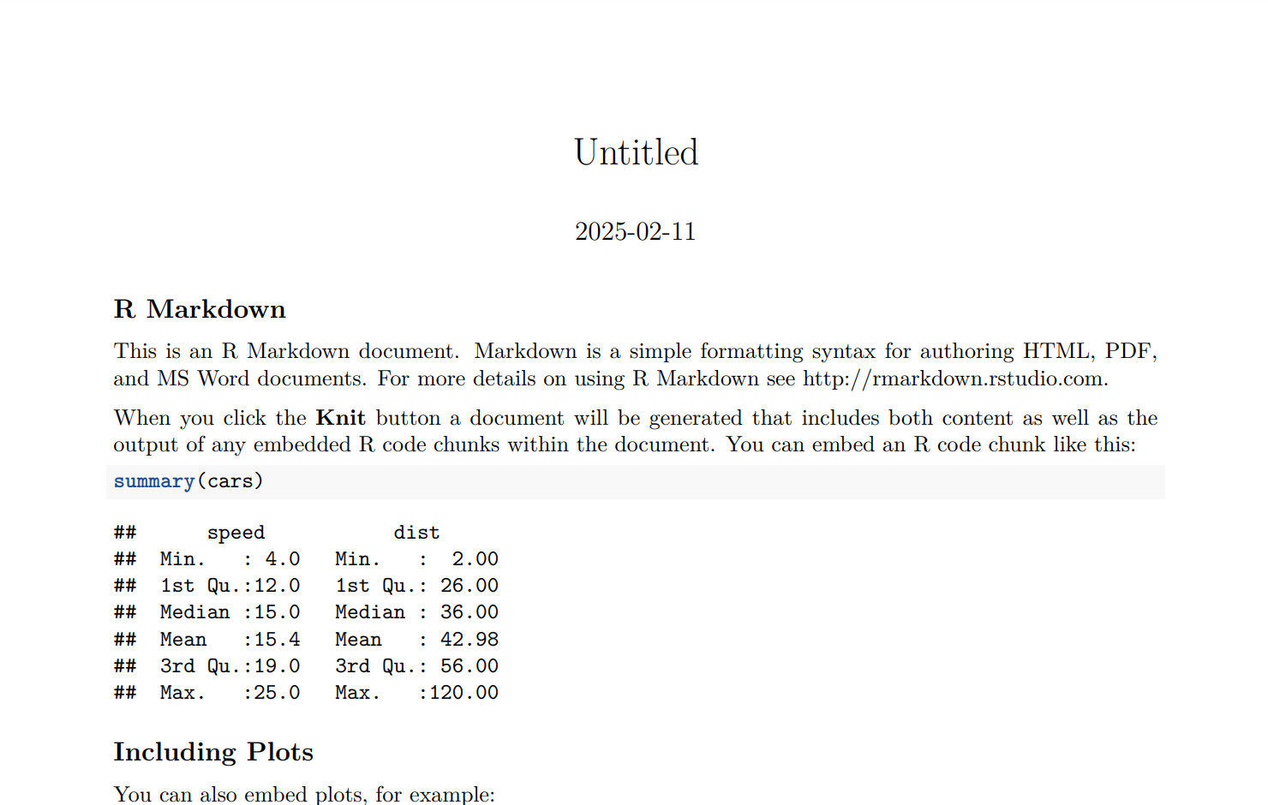
3. to PDF
Ugly, but it works!

Slide 21
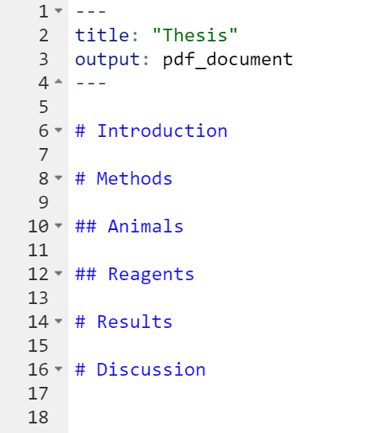
4. Delete all filler content, fill with your headers
# = Level 1
## = Level 2

Slide 22
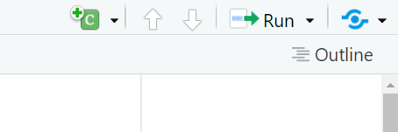
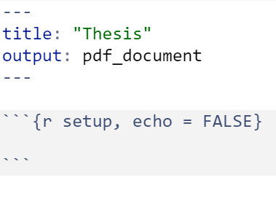
5a. Insert a new code chunk
Ctrl + Alt + I
5a. Name it (e.g. “setup”) and add echo = FALSE to hide it

Slide 23
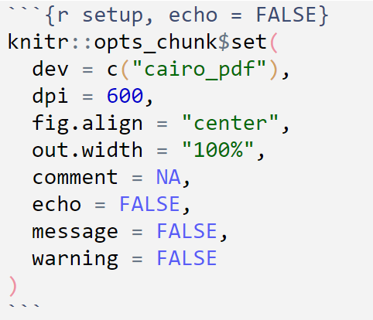
5c. Create a set-up chunk
Searchable text in figures (e.g. axis titles)
High-quality figure resolution
Set default width of the figures (% total page content width)
Remove ## in front of chunk output
Hide warnings and code chunks in output PDF

Slide 24
Figures

Slide 25
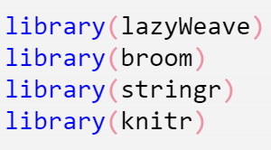
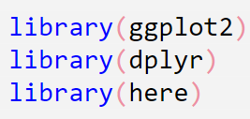
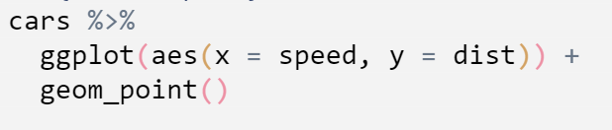
6. Load libraries in a new chunk
In this tutorial, you will also need these:
7. Create a simple plot

Slide 26
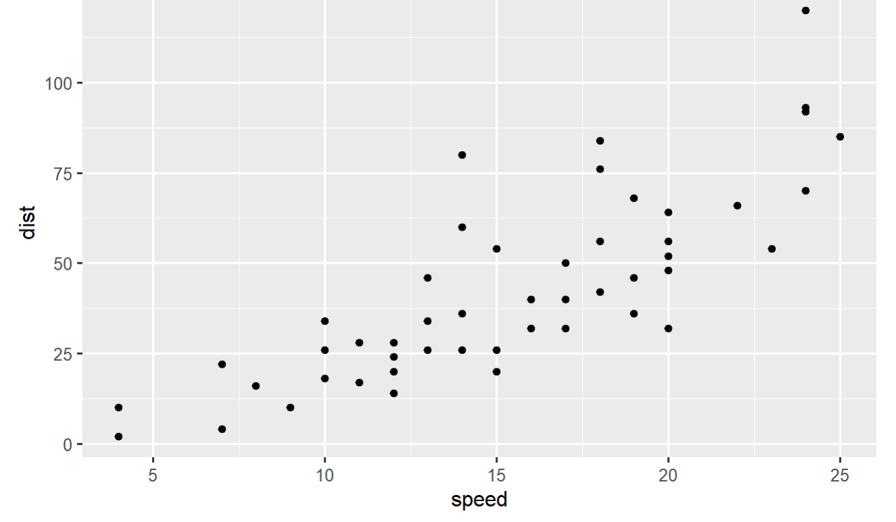
7b. Marvel at its beauty

Slide 27
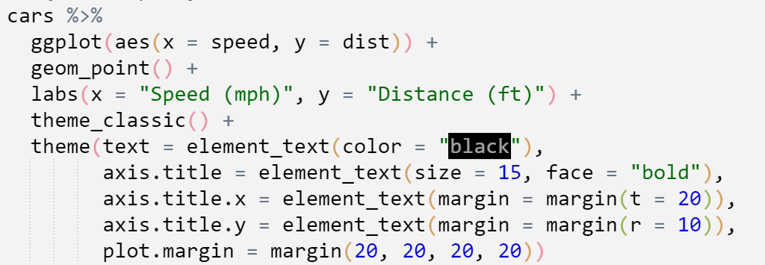
8. Make plot look better
Axis titles
No grid
Better margins

Slide 28
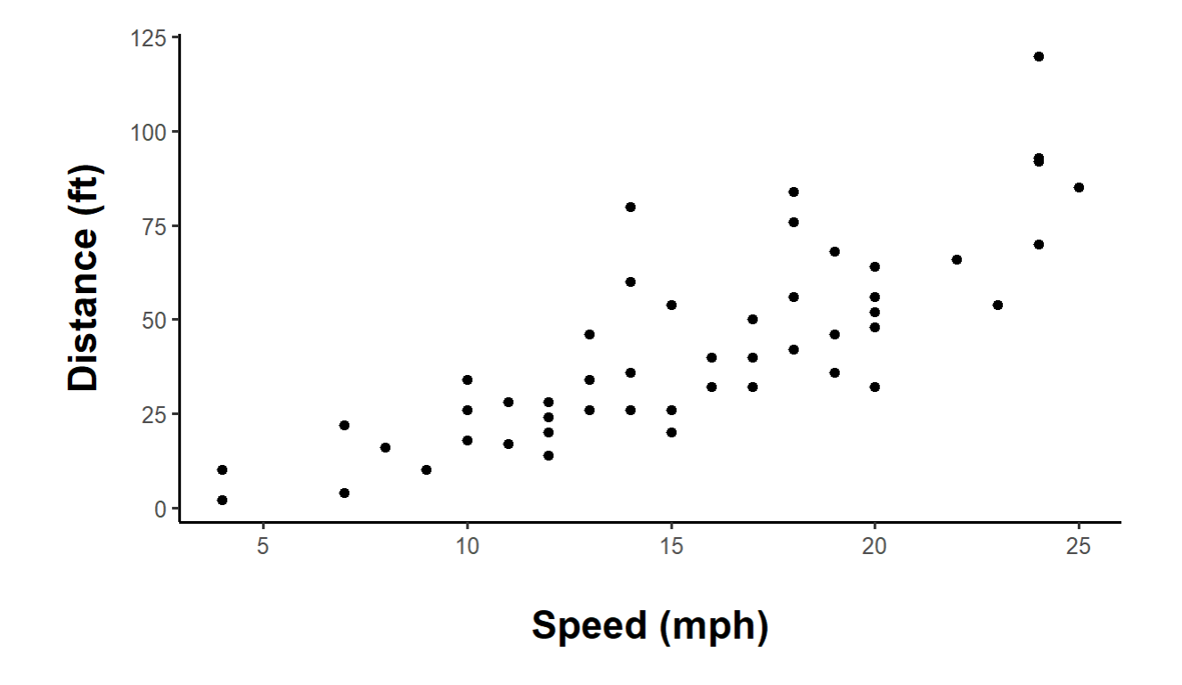
8. Better!

Slide 29
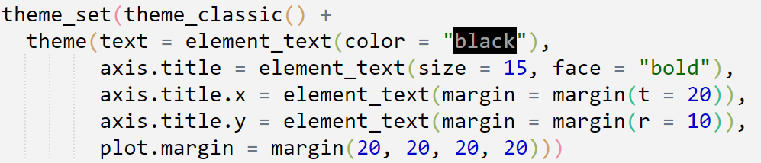
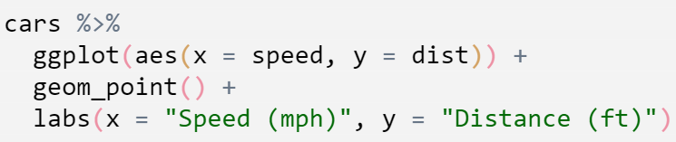
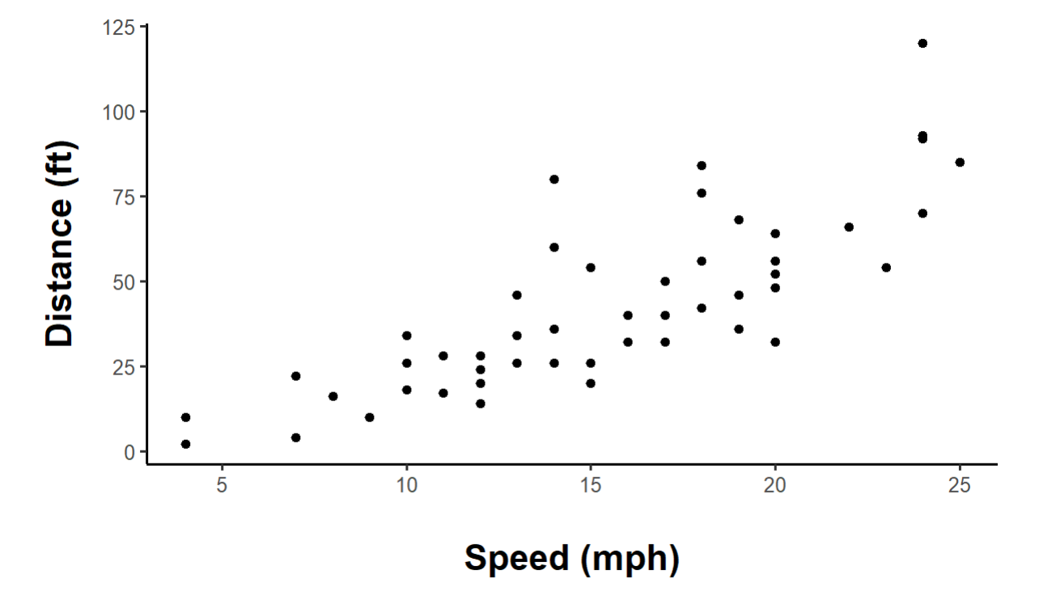
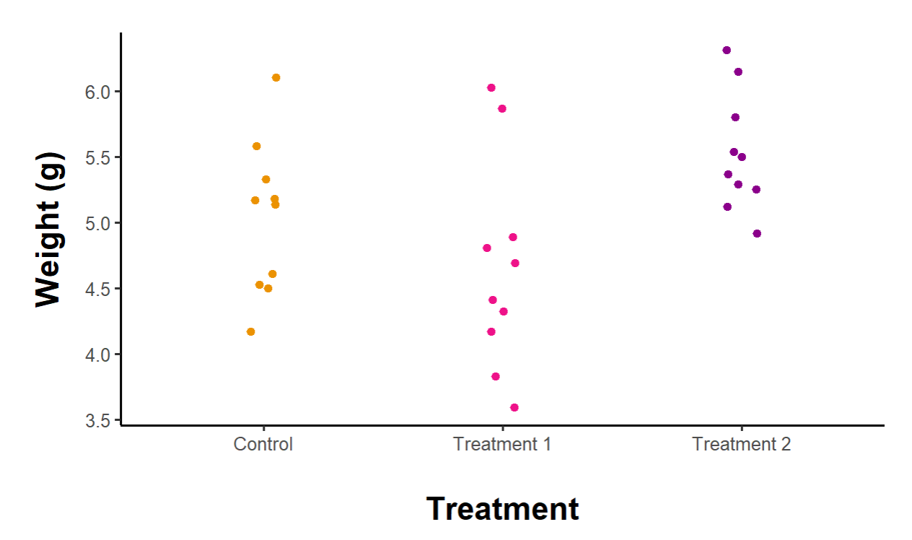
8b. Set default theme for all ggplots
Use theme_set() in a chunk near the top of the document
Reduces repetitive theme code in all plots

Slide 30
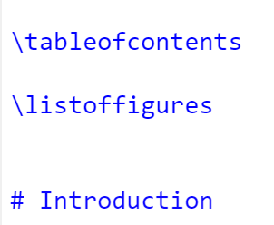
9. Add caption (fig.cap) and short caption (fig.scap)
10. Add a \tableofcontents and \listoffigures

Slide 31
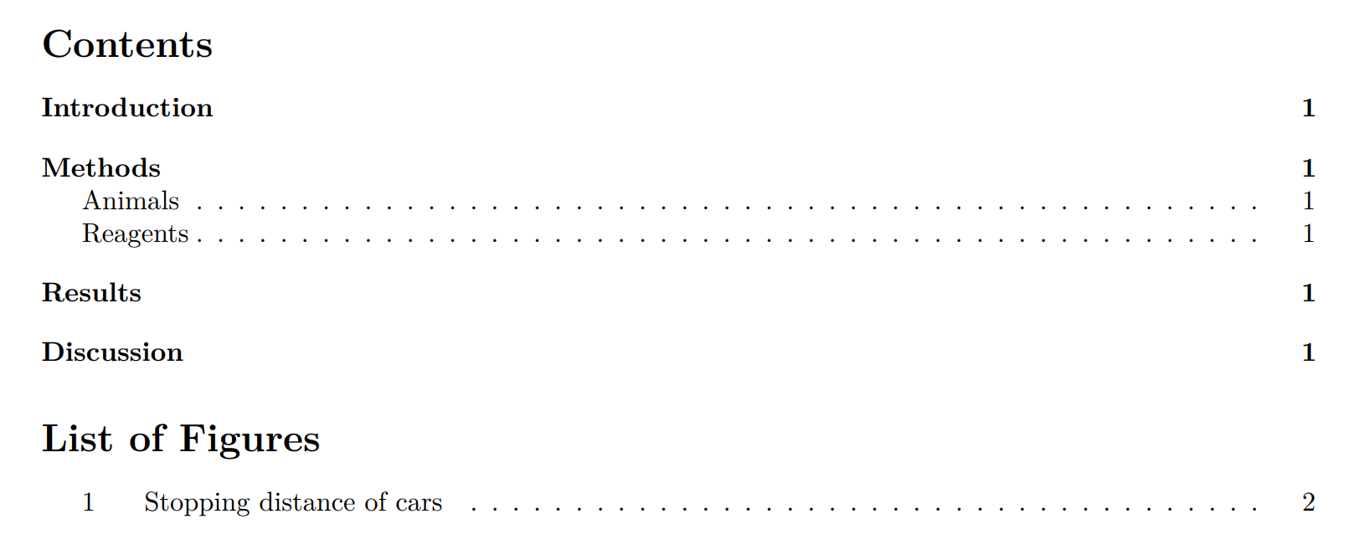
11. Knit to PDF!
Do NOT worry about formatting, fonts or spacing yet!
fig.scap

Slide 32
12. Cross-reference image with \ref{}
Must put \\label{} INSIDE the fig.cap quotations! No spaces!
Clickable!

Slide 33
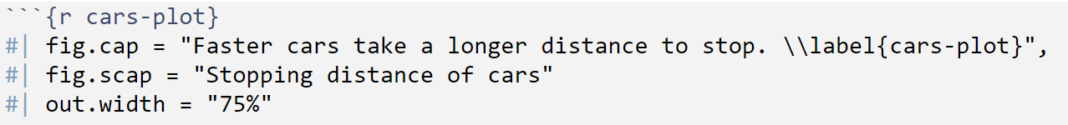
13. (Optional) change other parameters in the chunk options
Use #| to extend chunk options into a new line
\\textit{} = italics
Use \ to cancel special characters like “ or ‘

Slide 34
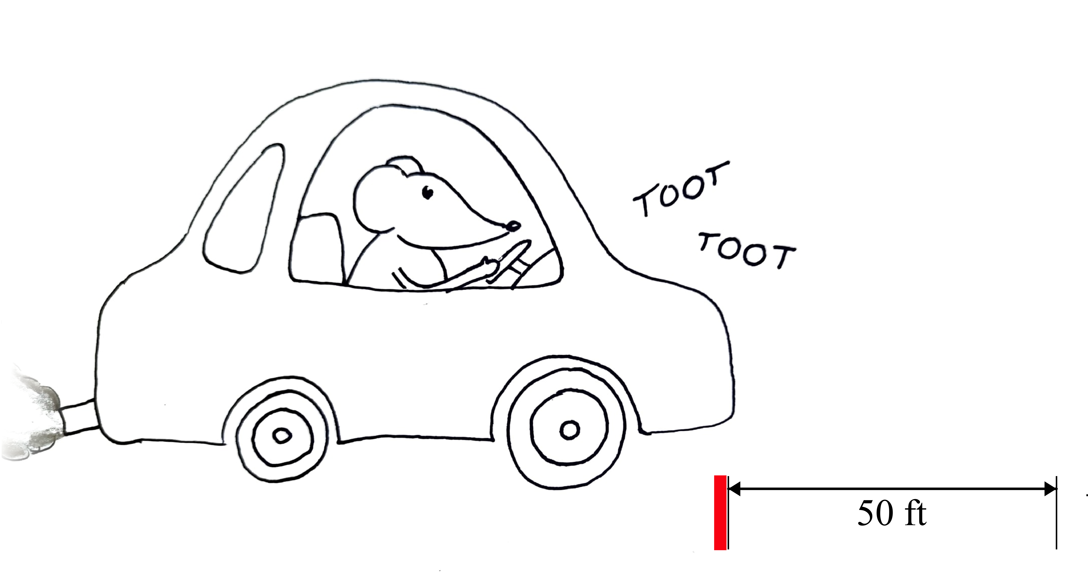
Methods schematic
* Not to scale

Slide 35
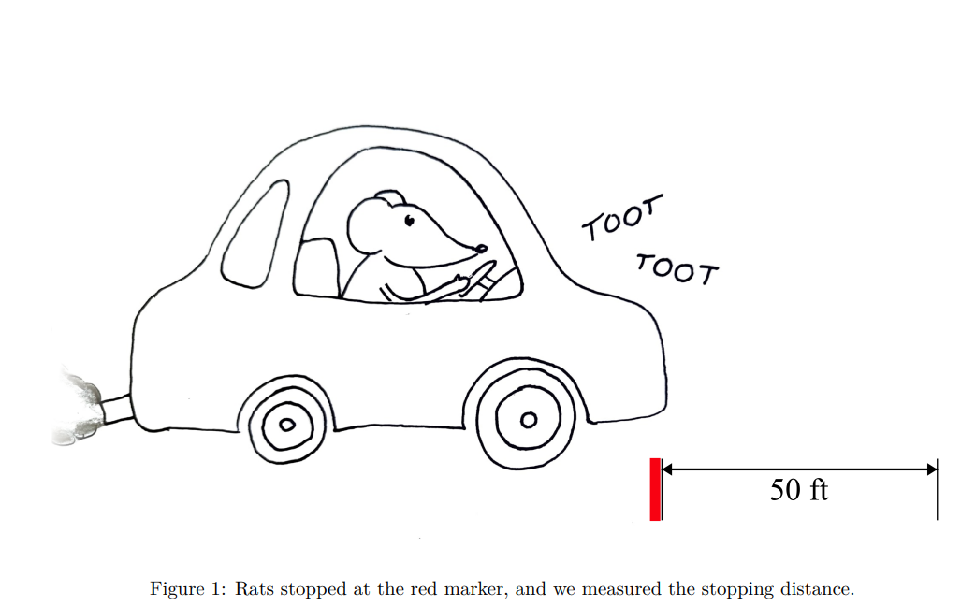
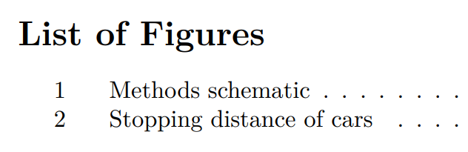
14. Insert images with knitr::include_graphics()
here() selects file in the “Figures” folder
Updated figures numbers

Slide 36
Statistics

Slide 37
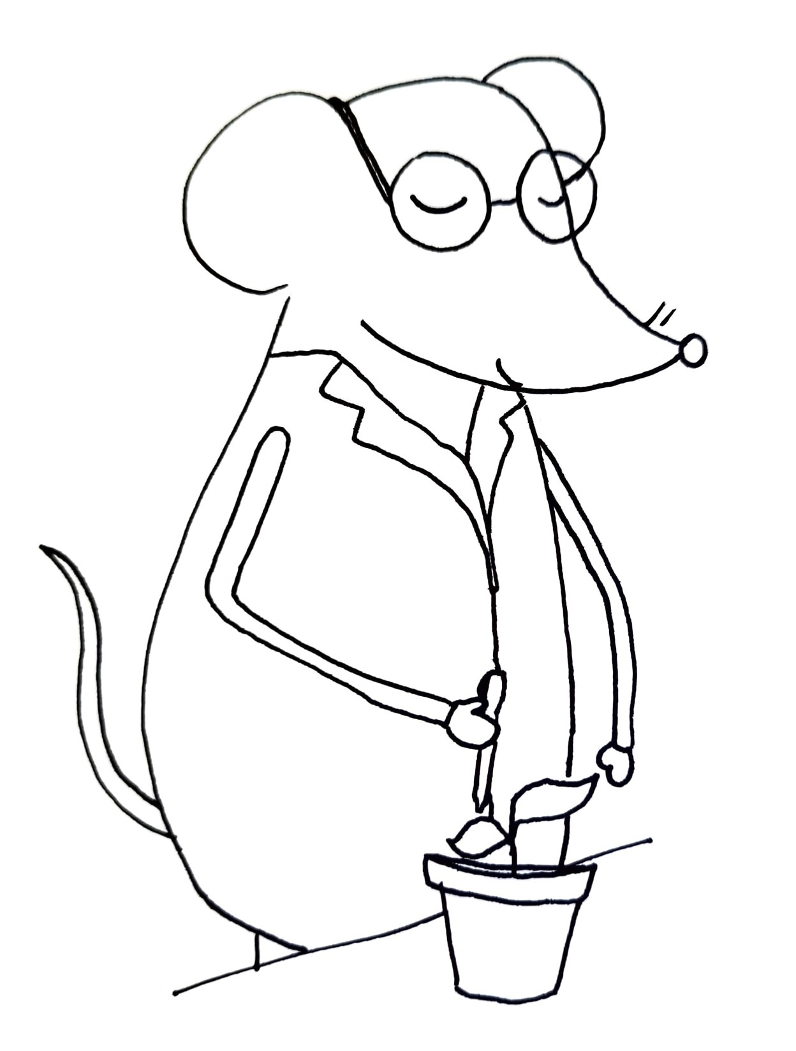
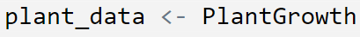
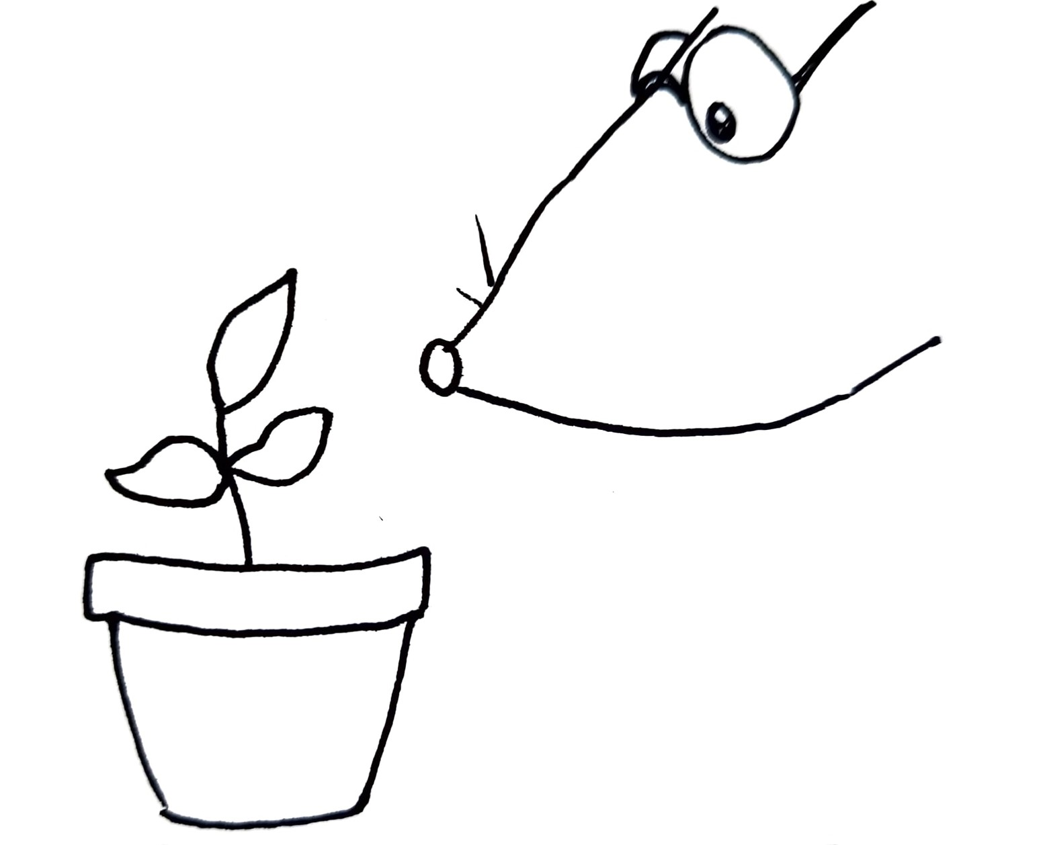
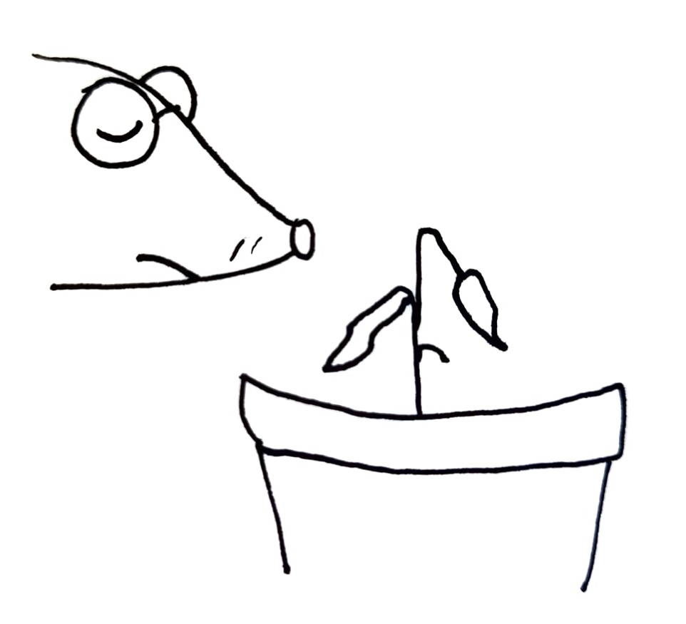
Analyzing Plant Growth
Control
Water
Treatment 1
Water + Herbicide
Treatment 2
Water + Fertilizer

Slide 38
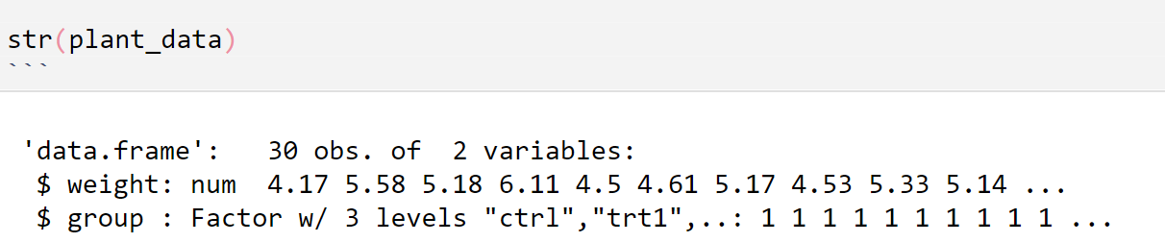
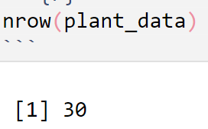
0. Explore data with str() and nrow()
Use chunk option include = FALSE to hide these printouts in your paper
= 30 plants

Slide 39
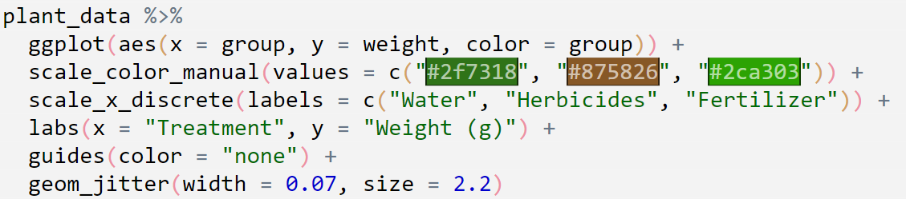
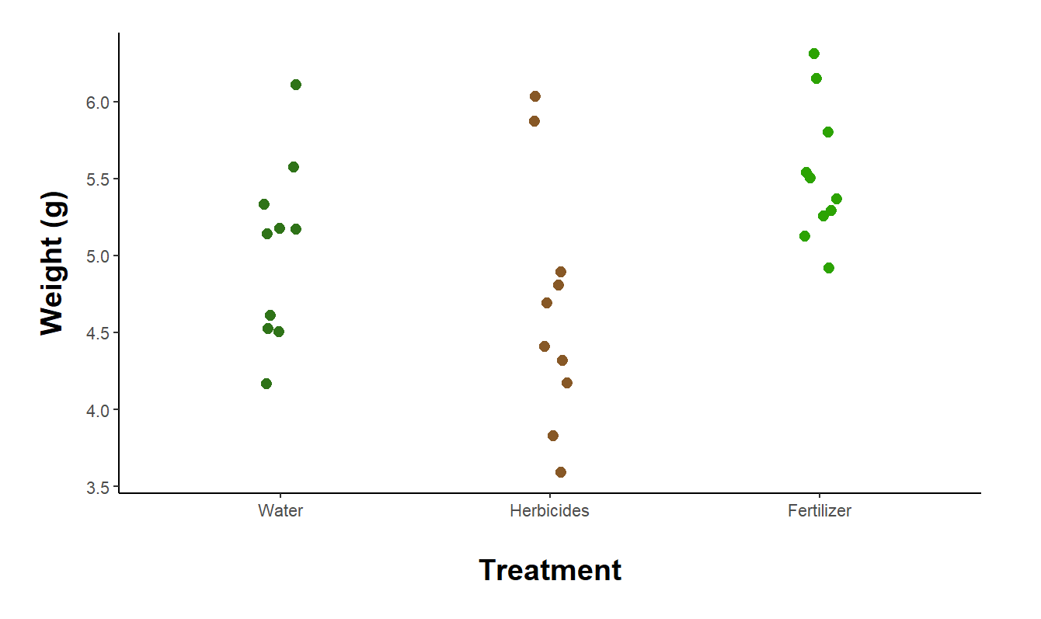
1. Plot data
2. Choose analysis
One-way Anova
Assess effect of treatment on growth

Slide 40
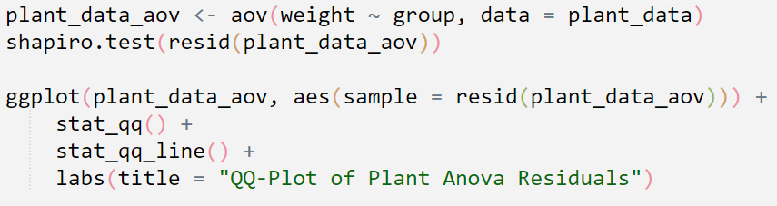
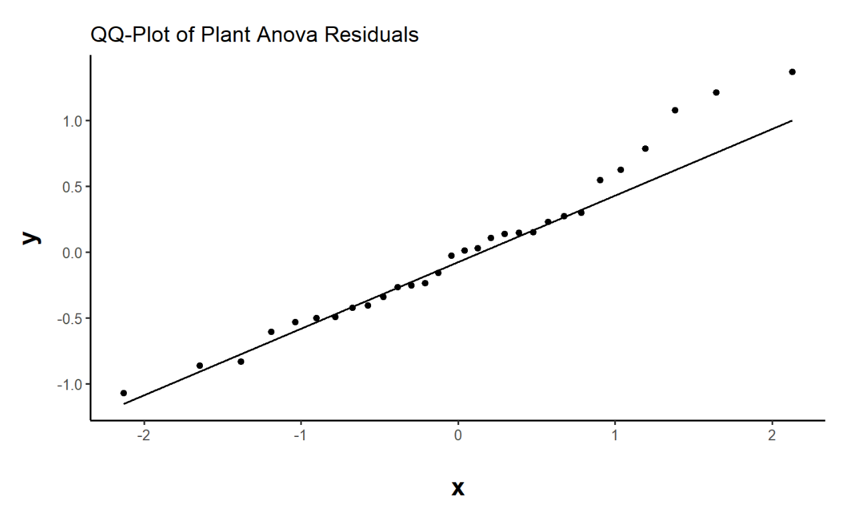
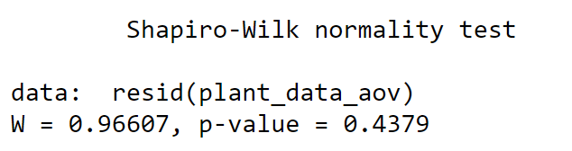
3. Test assumptions
Normality of residuals
Data are normal!

Slide 41


4. Interpret results
Treatment affects plant growth!

Slide 42

5. Report results
Backticks (above tab key) make a “mini chunk”

Slide 43



6. Extract p-values
Click on green arrow next to p-value

Slide 44


6. Extract p-values
Use [[1]] to select the first p-value, which is associated with treatment
pvalString() requires library(lazyWeave)
Make publication-style p-values, like p < 0.001

Slide 45

7. Make publication-quality ANOVA table

Slide 46

7a. Make dataframe
tidy() requires library(broom)
tidy() produces a dataframe instead of a printout

Slide 47

7b. Round values & rename columns
Round values
Capitalize names.
str_to_title() requires library(stringr)
Make pretty column titles

Slide 48

7c. Use kable()
kable() requires library(knitr)
Uses the booktabs style (horizontal lines around header row and bottom last row)
Don’t put a space every 5 rows
Make first column wider

Slide 49
7c. Use kable()

Slide 50
7c. Use kable()

Slide 51
Customization

Slide 52

8. Customize PDF
Spacing?
Fonts?
Page margins?

Slide 53


8. Improve spacing

Slide 54


8. Prepare for printing
Exaggerated binding offset!

Slide 55


8. Modify preamble
Create a new .tex file and save it
I used the Templates folder
../ = go up one folder. Reference point is the location of Thesis.Rmd, which is in Thesis/ folder

Slide 56


8. Modify preamble

Slide 57

8. Modify preamble
Change paragraph spacing
Include list of figures in TOC
Make a new font size
Increase padding around headers and make headings larger
Make heading 1 start on a new page

Slide 58



Slide 59
Fonts

Slide 60



8. Custom font
Must specify XeLaTeX engine in your YAML or it will NOT work!

Slide 61

8. Custom font
Put .otf or .ttf files in Templates/
EBGaramond12-Regular.otf
EBGaramond12-Italic.otf
Advanced typography, e.g. contextual alternates

Slide 62



Slide 63

Google Fonts
https://fonts.google.com/
Download a font
Place .otf or .ttf file in Templates/ folder

Slide 64


Google Fonts

Slide 65

Title Page
Put title in YAML

Slide 66



Slide 67



Requires adforn package
Decorative symbols
Add this code to the preamble:

Slide 68
Citations

Slide 69


Citations in Zotero
Automatically-updating .bib file in Zotero
Use the better BibTeX plugin (https://retorque.re/zotero-better-bibtex/installation/)
Tools -> Plugins -> Install Plugin from File
Choose the .xpi file you downloaded

Slide 70

Set BetterBibTeX citation keys
Edit -> Preferences -> Better BibTeX
auth.lower + year
wang2024

Slide 71

Set BetterBibTeX citation keys
Select all entries, right-click -> Better BibTeX -> Refresh BibTeX key

Slide 72

Citations in Zotero
Save in the same folder as the thesis
Check keepUpdated

Slide 73



Citations in Zotero

Slide 74

Will automatically appear at the bottom of your document.
Last line of your Thesis.Rmd should be # References

Slide 75

What you’ll look like when you finish your awesome paper!

